Slide 1

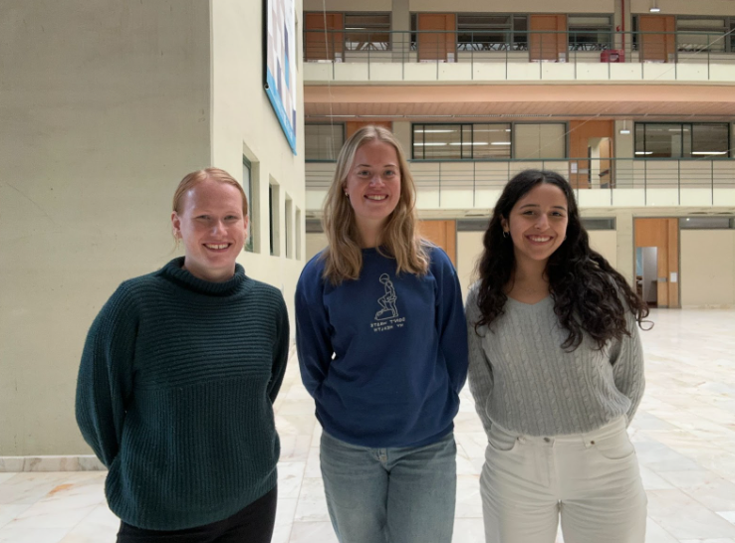

Home Security
Monitoring
Notes:
Tuva

Slide 2
Overview
Project overview
General architecture
Live demonstration
Communications
Setup
Conclusion
01
02
03
04
05
06
Notes:
Tuva

Slide 3

Oven system
Project overview
Door system
Notes:
Tuva

Slide 4
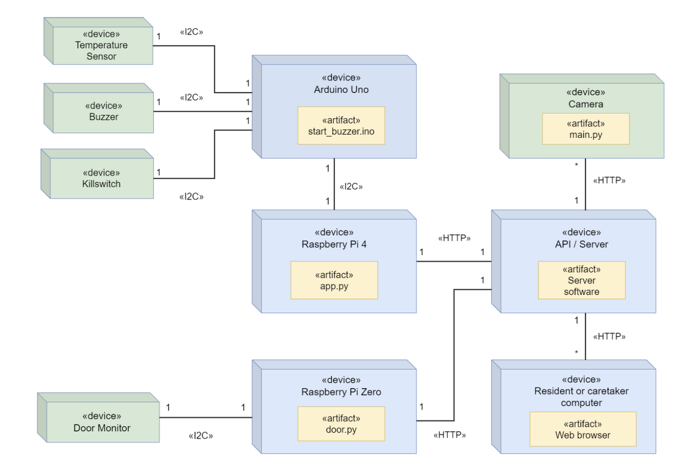
General architecture
Oven monitor
RPi4
Arduino
Temperature sensor
Buzzer
Killswitch
(Camera)
Door monitor
RPi zero
Door circuit
Dashboard
React.js
Tailwindcss
HTTP, Flask
Notes:
Tuva

Slide 5
Live demonstration
Notes:
Francisca
Imagine this is the house of a VERY forgetful person. They come home from their trips at the end of the day and decide to get started on dinner. *Turn on candle*. While they are cooking, they get a call from their neighbor asking for help, for which they go immediately, leaving not only the stove top on, but also the door. *Add tube for heat*. After a while, they keep chating with their neighbor, and by then they already completely forgot dinner. Of course, our system already started to detect some strange behavior, as you can see here the door being open for example. That's when the alarm starts to sound. *Remove tube and open modal on dashboard*. If they are lucky, they can hear the alarm from the neighbor's house and come back to turn everything off. If not, any family member or caregiver with access to the dashboard can automatically turn it off remotely. *Turn off in dashboard*. Eventually the person returns to their home, without a fire, but with a very burnt dinner.

Slide 6

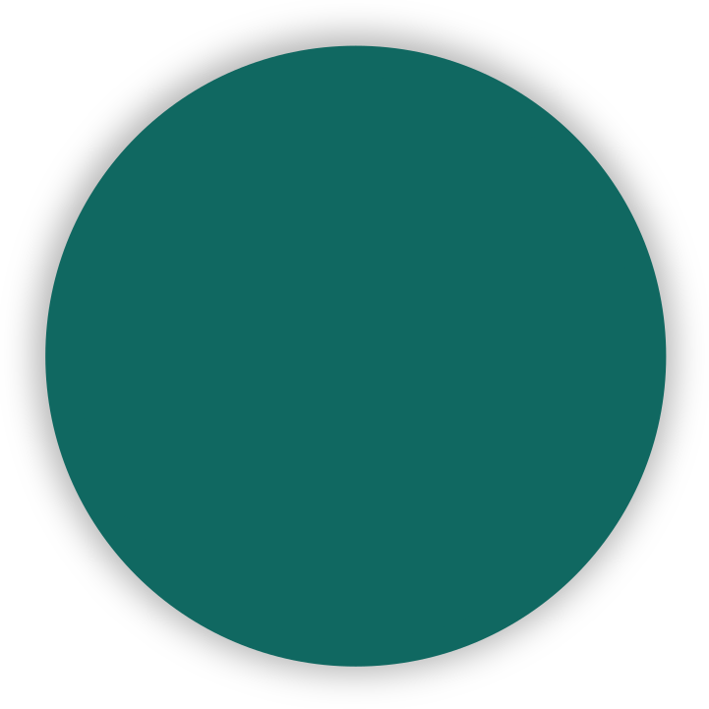
01
Communication
Oven
More in-detail description of how communications work
02
Door
03
Modal
04
Camera
Notes:
Tilde

Slide 7
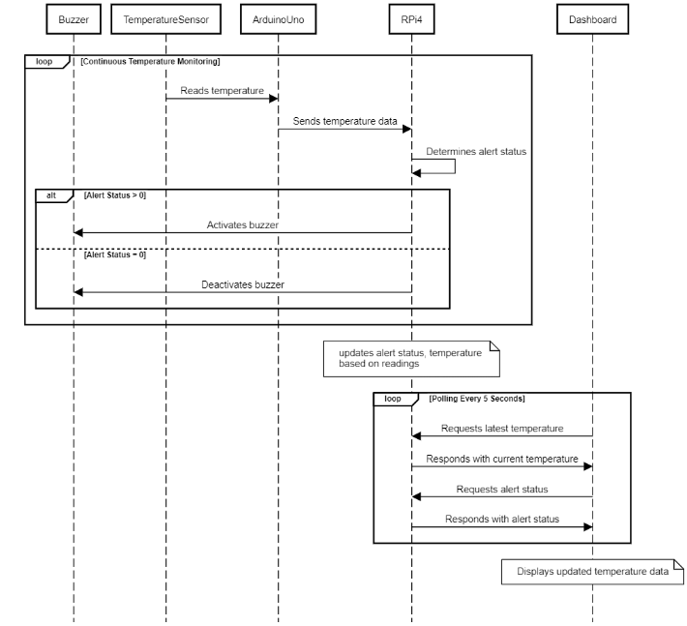
Oven
Notes:
Tilde

Slide 8
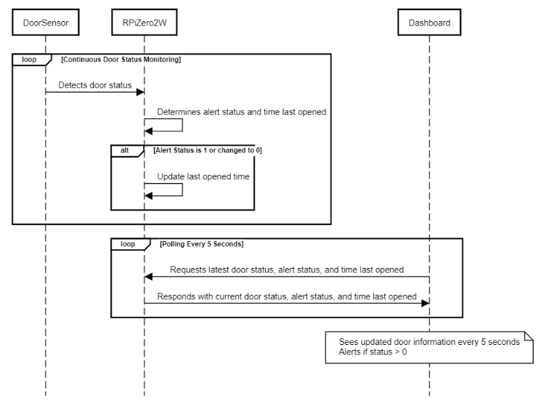
Door
Notes:
Tilde

Slide 9
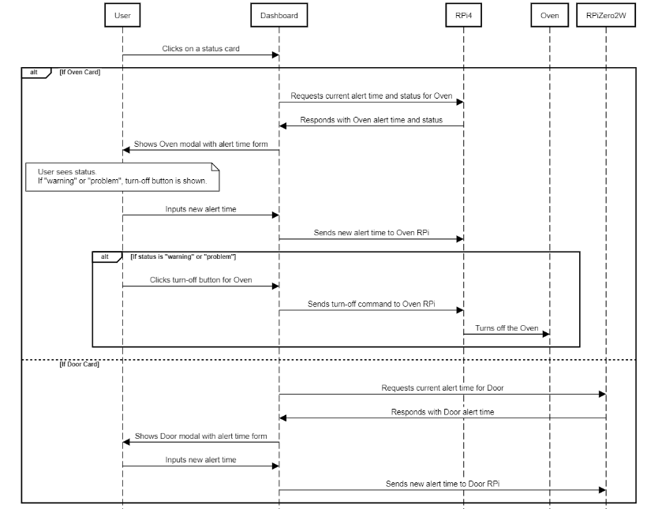
Modal
Notes:
Tilde

Slide 10
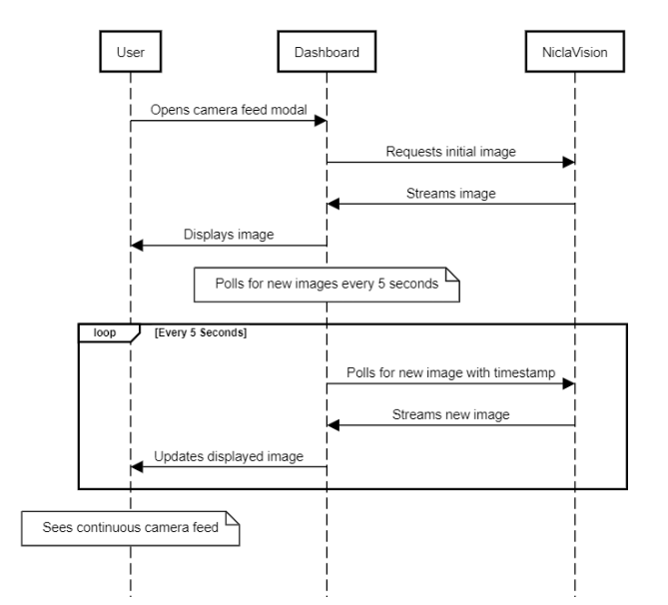
Camera
Notes:
Tilde

Slide 11

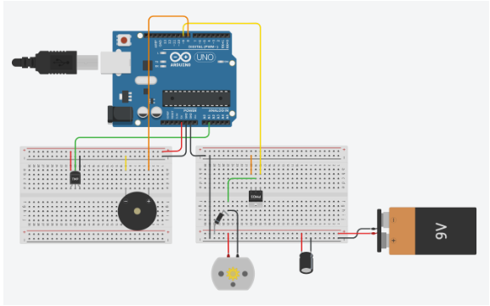
Setup
Notes:
Francisca

Slide 12

Final notes
The system provided is a prototype
More appliances
Real killswitch
Security
What value is added?
Safety and independence
Reassurance
Elders
Family
Anxiety/ADHD
Killswitch and visual confirmation
Notes:
Tilde

Slide 13
THANK YOU
For watching this presentation
Francisca Silva
Tuva Tholo
Tilde Eine
Notes:
Tilde

